Slide 1
AUTOMATIC DIABETIC RETINOPATHY SCREENING USING DEEP LEARNING
By
Amitkumar Manojkumar Rautray
National Institute of Science and Technology Berhampur
Under the guidance of
Mr. Pradeep Kumar Jena
Notes:
B-TECH PROJECT MID-SEM PRESENTATION 2011
BY KHUSHBU KHAN & ISAN SAHOO

Slide 2
OUTLINE
Introduction
Objective
Databases
Stages of Framework
Pre-processing
Candidate Segmentation
Auto-encoder
Removal of Segmented Parts
Classification
DR-Screening
Results
Work Analysis
References
Conclusion
Notes:
B-TECH PROJECT MID-SEM PRESENTATION 2011
2

Slide 3
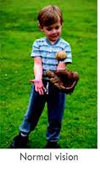
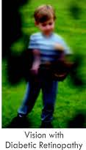

INTRODUCTION
Diabetic Retinopathy(DR) is a disorder in which the retina gets injured due to leakage of blood and this causes vision loss.
The initial signs of DR that appear on the surface of the retina are microaneurysms, hemorrhages, and exudates.
Notes:
B-TECH PROJECT MID-SEM PRESENTATION 2011
BY KHUSHBU KHAN & ISAN SAHOO
3

Slide 4
OBJECTIVE
This project is aimed at building a model that will grade the fundus image of retina according to their severity.
Grading makes it easier to identify the severity and hence necessary actions can be taken accordingly.
A deep learning approach is used in our framework for DR-grading of fundus images.
Notes:
B-TECH PROJECT MID-SEM PRESENTATION 2011
BY KHUSHBU KHAN & ISAN SAHOO
4

Slide 5
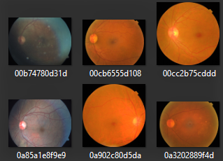
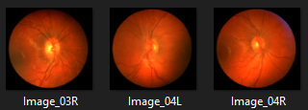
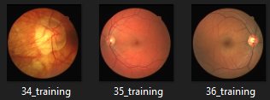
NAME | SAMPLE | RESOLUTION / SIZE | USAGE
APTOS |  | 2400 x 2300 / 4.5 GB | DR -Screening
CHASE |  | 1000 x 1000 / 2.24 Mb | Blood vessel-Segmentation
DRIVE |  | 500 x 500 / 30 Mb | Optic Disk-Segmentation

Slide 6
METHODOLOGY
The steps are divided as:
Pre-processing
Candidate Segmentation
Removal of
Segmented part
Classification
Notes:
B-TECH PROJECT MID-SEM PRESENTATION 2011
BY KHUSHBU KHAN & ISAN SAHOO
6

Slide 7
Methodology
Notes:
B-TECH PROJECT MID-SEM PRESENTATION 2011
BY KHUSHBU KHAN & ISAN SAHOO
7

Slide 8
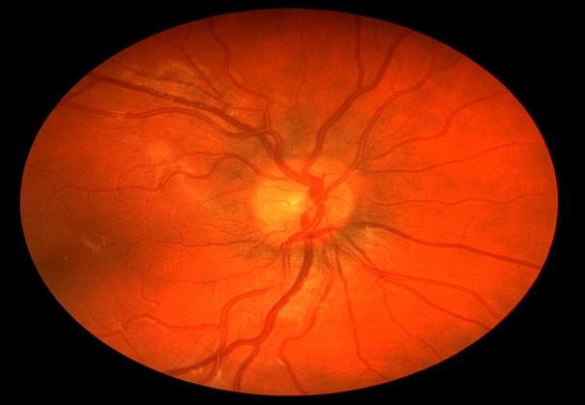
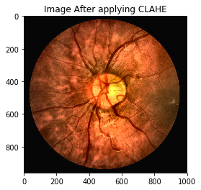
PRE-PROCESSING
This step commonly involves removing low-frequency background noise, normalizing the intensity and masking portions of images.
For improving segmentation efficiency of fundus images Contrast Limited Adaptive Histogram Equalization(CLAHE) is used.
Before pre-processing
After pre-processing
Notes:
B-TECH PROJECT MID-SEM PRESENTATION 2011
BY KHUSHBU KHAN & ISAN SAHOO
8

Slide 9

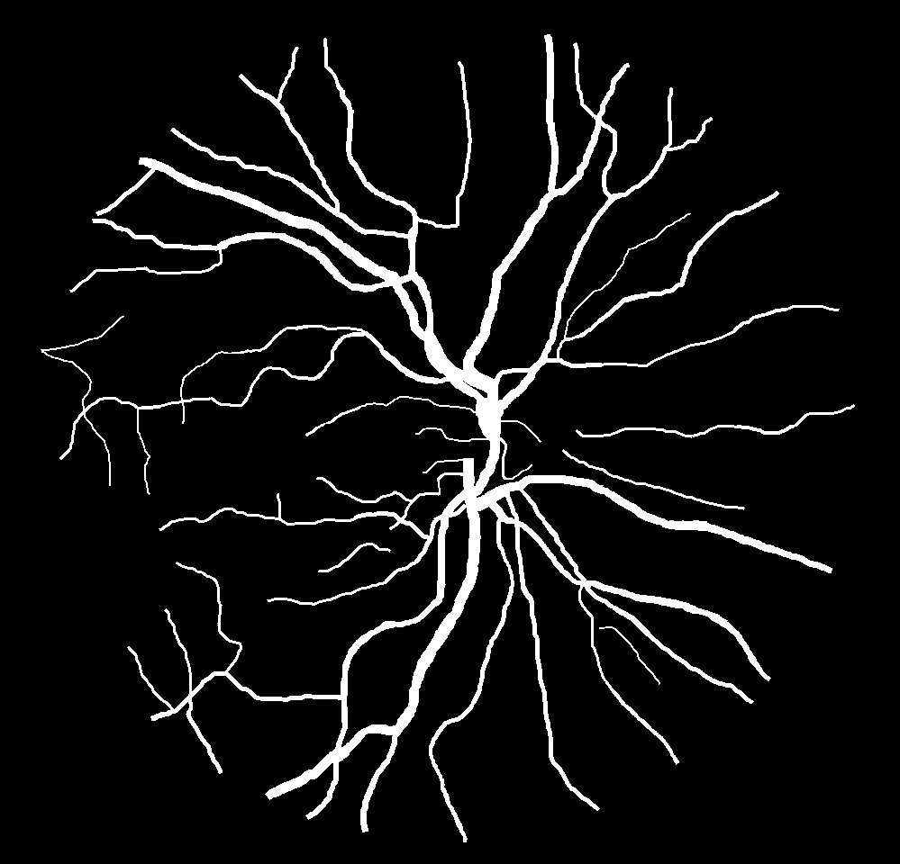

Candidate Segmentation
Image segmentation is the process of partitioning the image into multiple segments.
It outputs the segmented blood-vessel and optic-disk from the fundus image.
Original Image
Segmented Blood-vessels
Segmented optic Disk
Notes:
B-TECH PROJECT MID-SEM PRESENTATION 2011
BY KHUSHBU KHAN & ISAN SAHOO
9

Slide 10
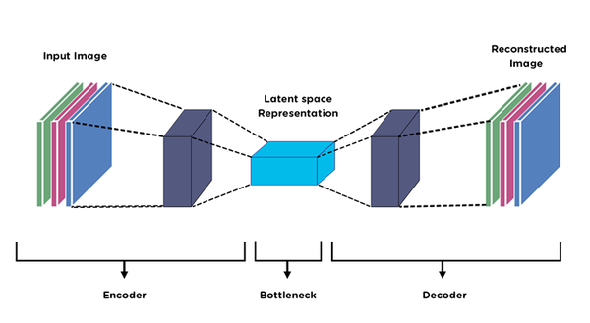
AUTO-ENCODER
There are various methods available for segmentation.
Since our database has a lot of variation in color-space, we have opted for Auto-encoder segmentation technique.
It is a Deep-Learning approach which trains over images in to generate masks and then implement on raw images for segmentation.
Notes:
B-TECH PROJECT MID-SEM PRESENTATION 2011
BY KHUSHBU KHAN & ISAN SAHOO
10

Slide 11
REMOVAL OF SEGMENTED PORTION
The segmented parts are subtracted from the original images in order to get rid of blood-vessels and optic-disk that has less contribution in detection.
Notes:
B-TECH PROJECT MID-SEM PRESENTATION 2011
BY KHUSHBU KHAN & ISAN SAHOO
11

Slide 12
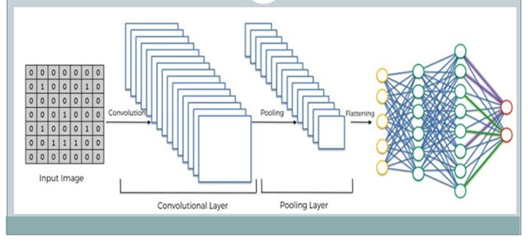
CLASSIFICATION
Convolutional neural networks (CNNs) are frequently used for the tasks of image classification.
The processed images are fed into the CNN and then it classifies them accordingly.
Notes:
B-TECH PROJECT MID-SEM PRESENTATION 2011
BY KHUSHBU KHAN & ISAN SAHOO
12

Slide 13
DR-GRADING
According to the severity of the diabetic the retinal images are affected. The gradation is done as mentioned below:
Class 0: Non-diabetic retinopathy.
Class 1: Microaneurysms, presence of mild diabetic retinopathy.
Class 2: Hemorrhages, moderate level DR without affecting the fovea.
Class 3: Exudates, severe DR condition that affect the fovea.
Notes:
B-TECH PROJECT MID-SEM PRESENTATION 2011
BY KHUSHBU KHAN & ISAN SAHOO
13

Slide 14
RESULT
The performances of model are presented in terms of recall, precision, accuracy and F1-score values.
Class | Precision | Recall | F1-Score | Accuracy
0 | 88.80 | 93.65 | 91.16 | 91.70
1 | 82.78 | 88.72 | 85.64 | 94.20
2 | 91.88 | 82.06 | 86.69 | 93.40
3 | 96.00 | 83.72 | 89.44 | 98.30
Notes:
B-TECH PROJECT MID-SEM PRESENTATION 2011
BY KHUSHBU KHAN & ISAN SAHOO
14

Slide 15
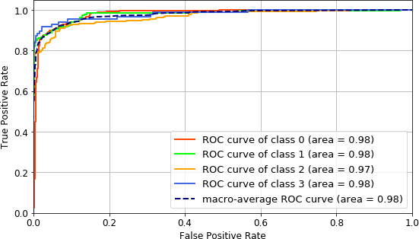
WORK ANALYSIS
We have compared the average sensitivity and specificity values of all our four classes with others.
Notes:
B-TECH PROJECT MID-SEM PRESENTATION 2011
BY KHUSHBU KHAN & ISAN SAHOO
15

Slide 16
WORK ANALYSIS
We have compared the average sensitivity and specificity values of all our four classes with others.
Methods | Accuracy
Kedir M. Adal et al. | 92.30
S. S. Rahim et al | 55.00
Kumar S. et al | 93.00
Proposed method, APTOS dataset | 98.07
Notes:
B-TECH PROJECT MID-SEM PRESENTATION 2011
BY KHUSHBU KHAN & ISAN SAHOO
16

Slide 17
CONCLUSION
Here, an effective image DR-grading is presented by implementing the methods. Its worth of mentioning that the better OD, BV segmentation and contrast enhancement of the retinal images improves the of DR grading.
Further investigation can be done on medical image analysis using deep learning-based image segmentation and deep learning approaches to support the clinical process.
Notes:
B-TECH PROJECT MID-SEM PRESENTATION 2011
BY KHUSHBU KHAN & ISAN SAHOO
17

Slide 18
REFERENCE
[1]. Dong-Xia Zhang, Song Yang, Shu-Ya Song. “Hemorrhages Detection in Fundus Image Based on Human Visual Characteristics ”. International Journal of Engineering Inventions. Jan, 2018 .
[2]. Roberto Romero-Oraá , Jorge Jiménez-García , María García , María I. López-Gálvez , Javier Oraá-Pérez and Roberto Hornero . “Entropy Rate Superpixel Classiﬁcation for Automatic Red Lesion Detection in Fundus Images” . 19 April, 2019
[3]. Godlin Atlas , Kumar Parasuraman. “Detection of retinal hemorrhage from f undus images using ANFIS classifier ” .Biomedical Research 2018; 29 (7): 1489 . 28 Jul, 2018 http://www.biomedres.info
[4]. Sonali S. Gaikwad, Ramesh R. Manza . “Detection of Hemorrhage from Retinal Images Using Digital Image Processing Techniques ”. 2017 IJEDR Volume 5, Issue 4 ISSN: 2321-9939. http://www.ijedr.org
.2016
Notes:
B-TECH PROJECT MID-SEM PRESENTATION 2011
BY KHUSHBU KHAN & ISAN SAHOO
18

Slide 19
THANK YOU…

